Slide 1


REVOLUTIONIZING EDUCATION: BIG DATA IN EDTECH
Presented by Team SG:
12214685 Bakhromov Makhmudbek
12214711 Narbutaeva Elmara
12220241 Abdurakhmonova Mokhinur
12250106 Junrui Chen

Slide 2

INTRODUCTION TO EDTECH
Importance in the 21st Century:
Supports remote and hybrid learning.
Addresses diverse student needs.
Prepares students for a tech-driven world.
EDTECH IS TRANSFORMING EDUCATION TO BE MORE ACCESSIBLE AND EFFECTIVE.

Slide 3


CHALLENGES IN TRADITIONAL EDUCATION
One-Size-Fits-All Approach: Fails to address individual student needs.
Inefficiency: Limited insights into student progress or engagement.
Lack of Data-Driven Decisions: Teachers and institutions rely on intuition, not evidence.
Impact: Lower engagement, higher dropout rates, and outdated curricula.

Slide 4
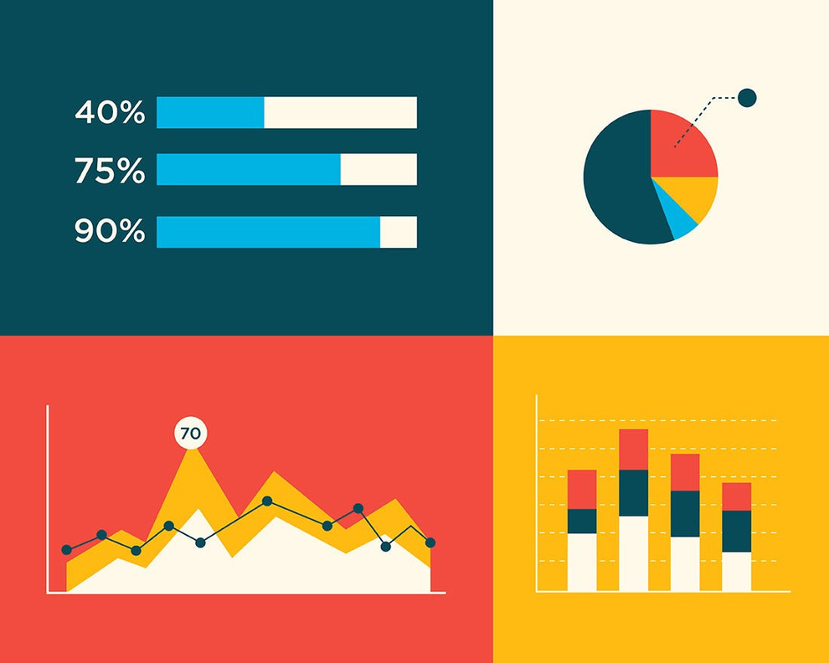
WHY BIG DATA MATTERS IN EDUCATION
Large, complex datasets analyzed to reveal patterns and trends.
Relevance to EdTech:
Massive student data (e.g., grades, login times, quiz responses).
Tracks behavior (e.g., time spent on tasks, video pauses).
Enables real-time performance monitoring.
Impact: Informs personalized learning, optimizes teaching, and improves outcomes.

Slide 5




PROJECT OBJECTIVES
Investigate how Big Data is applied in EdTech (e.g., tools, platforms, case studies).
Identify benefits (e.g., improved learning outcomes, efficiency).
Highlight challenges (e.g., privacy, implementation costs).
Explore future trends (e.g., AI, AR/VR in EdTech).

Slide 6

BIG DATA IN EDTECH: KEY APPLICATIONS
Personalized Learning: Tailoring lessons to individual student needs using data-driven insights.
Learning Analytics: Tracking student engagement, progress, and performance in real-time.
Predictive Analytics: Forecasting student outcomes (e.g., risk of dropping out) to enable early interventions.
Curriculum Optimization: Using data to refine course content and teaching methods.
Intelligent Tutoring Systems: AI-driven platforms that adapt to student learning patterns.

Slide 7
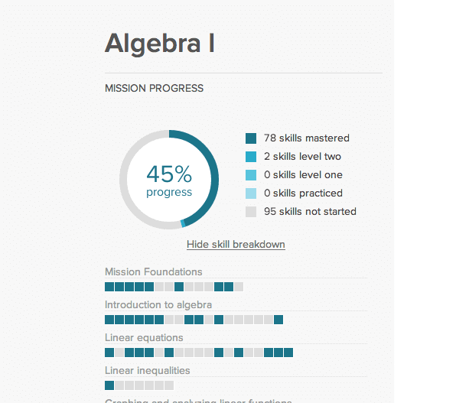
PERSONALIZED LEARNING WITH BIG DATA
What It Is: Adaptive learning platforms analyze student data (e.g., quiz scores, time spent on tasks) to customize content.
How It Works: Algorithms identify strengths/weaknesses and adjust difficulty, pacing, or resources.
Examples:
Khan Academy: Uses data to suggest practice problems based on student performance.
Coursera: Recommends courses and adjusts content based on learner progress.

Slide 8
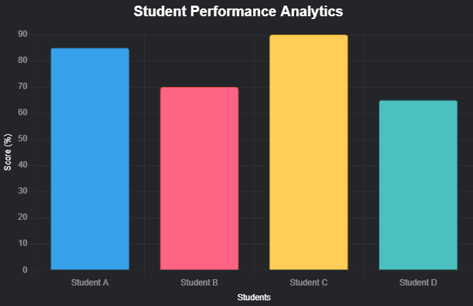
LEARNING ANALYTICS
What It Is: Collecting and analyzing data on student interactions (e.g., clicks, time on task, quiz results).
Applications:
Dashboards for instructors to monitor class performance in real-time.
Institutional insights for resource allocation and program evaluation.
Benefits:
Identifies struggling students early.
Improves teaching strategies with data-driven feedback.
Example: Learning Management Systems (LMS) like Canvas or Blackboard provide analytics dashboards.
This chart visualizes sample student quiz scores, making the concept of learning analytics tangible.

Slide 9
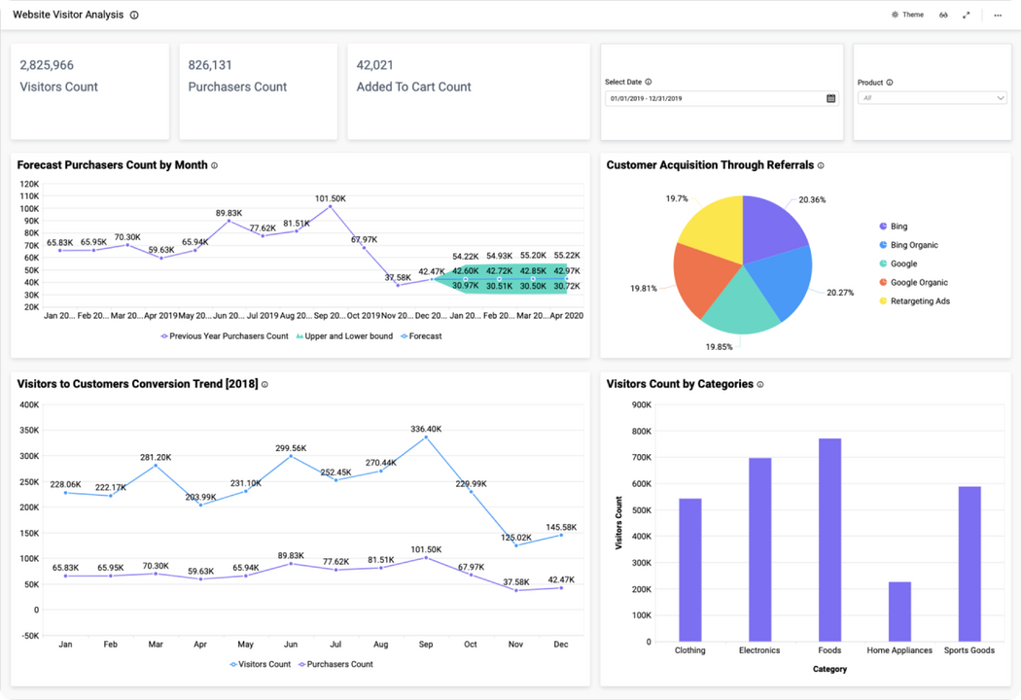
PREDICTIVE ANALYTICS
What It Is: Using historical and real-time data to forecast student performance or risks (e.g., dropouts).
How It Works: Machine learning models analyze patterns (e.g., attendance, grades, engagement).
Example: Purdue University’s Course Signals:
Traffic-light system (red/yellow/green) to indicate student risk levels.
Increased retention rates by identifying at-risk students early.
Benefits: Enables timely interventions, improves retention, and optimizes resources.

Slide 10
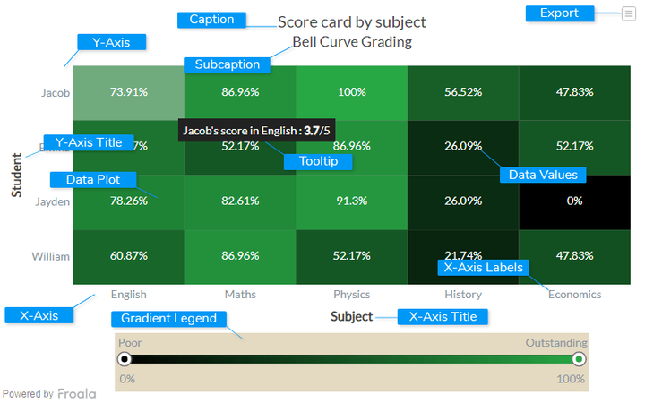
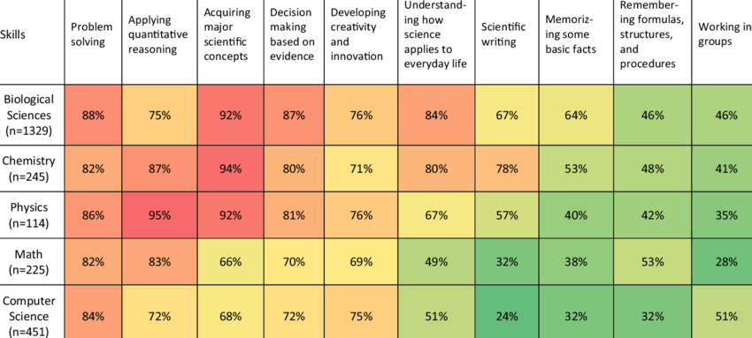
CURRICULUM OPTIMIZATION
What It Is: Using student performance data to improve syllabi, lesson plans, and teaching strategies.
How It Works:
Analyze which topics students struggle with (e.g., low quiz scores on calculus).
Adjust content delivery (e.g., more examples, interactive tools).
Real-Time Feedback Loops: Data from current students informs immediate curriculum tweaks.
Example: Universities using LMS data to revise courses each semester.
Benefits: Keeps curricula relevant, engaging, and effective.

Slide 11
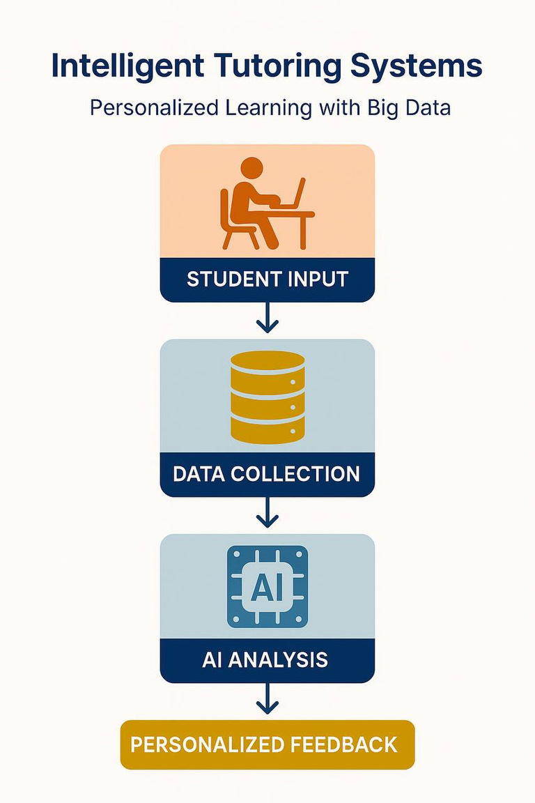


Intelligent Tutoring Systems
PERSONALIZED LEARNING WITH BIG DATA
AI tutors analyze student behavior, responses, and progress using Big Data
They adapt in real time just like a human tutor
Improve learning speed, retention, and engagement
Carnegie Learning
Uses machine learning + cognitive science
Tracks millions of data points to personalize math learning
Offers real-time feedback and adjusts content dynamically

Slide 12



EdTech Startups & Tools Powered by Big Data
REVOLUTIONIZING EDUCATION: BIG DATA IN EDTECH STARTUPS
Knewton: Analyzes how each student learns, adapts content in real time
DreamBox: For K-8 math; uses over 50,000 data points per hour per student
Duolingo: Tracks millions of learners to optimize lesson difficulity, timing and content
Big Data Analysis

Slide 13

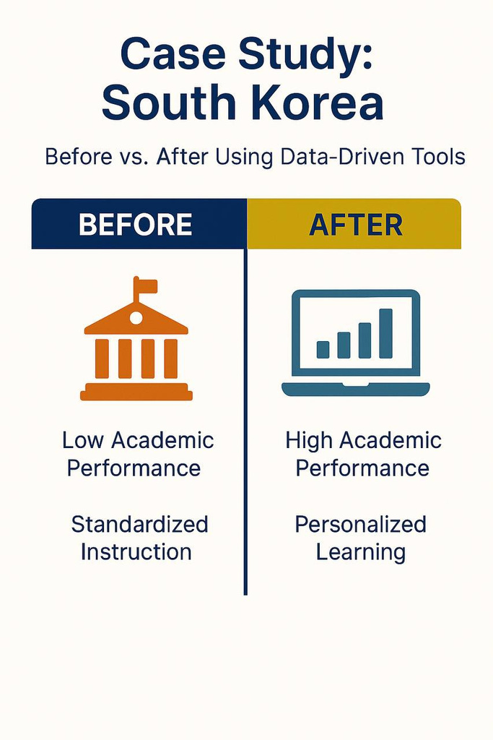


Case Study: South Korea
SOUTH KOREA: A DATA-DRIVEN EDUCATIONAL SUCCESS
Before:
High-pressure traditional schooling
Rote memorization, limited personalization
After Implementing Big Data Tools:
Adaptive learning platforms
Real-time dashboards for student progress
More focus on creativity, critical thinking
SG

Slide 14

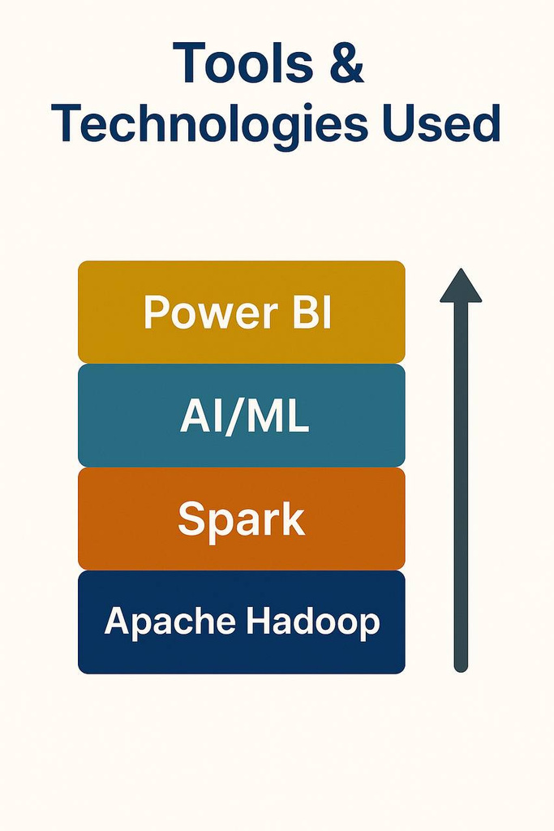


Tools & Technologies Used
THE BIG DATA TECH STACK IN EDTECH
Apache Hadoop: Data storage/distribution
Apache Spark: Fast data processing
Power BI: Interactive visualization
AI/ML Algorithms: Predictions, personalization
Cloud Platforms: AWS, Azure
[ Students ]
↓
[ Data Collection Tools (LMS, Apps) ]
↓
[ Hadoop / Spark ]
↓
[ AI / ML Algorithms ]
↓
[ Visualization: Power BI / Dashboards ]

Slide 15

Ethical Concerns
ETHICAL PITFALLS IN DATA-DRIVEN EDUCATION
Student Privacy: Risk of personal data misuse.
Data Bias: Algorithms may reinforce stereotypes.
Surveillance: Over-monitoring students can affect mental health.
Consent & Transparency: Do students know how their data is used?
"With great data comes great responsibility."

Slide 16


CHALLENGES IN IMPLEMENTATION
Implementing EdTech and Big Data in education isn’t without its friction. Key challenges include:
High Initial Costs: Infrastructure, software licenses, and hardware require significant investment.
Data Integration Issues: Existing systems often lack compatibility, making it difficult to unify student data across platforms.
Teacher Training Gaps: Without proper training, educators can’t fully utilize EdTech tools, weakening their impact.
Resistance to Change: Traditional mindsets in faculty or administration can slow adoption and innovation.

Slide 17

FUTURE TRENDS IN EDTECH & BIG DATA
As technology evolves, several emerging trends are shaping the next era of education:
AI-Powered Tutors: Adaptive, personalized learning experiences driven by intelligent algorithms.
AR/VR Enhanced Learning: Immersive environments enriched with real-time data for deeper engagement.
Emotional Analytics: Leveraging AI to assess student emotions and engagement, enabling timely interventions.

Slide 18

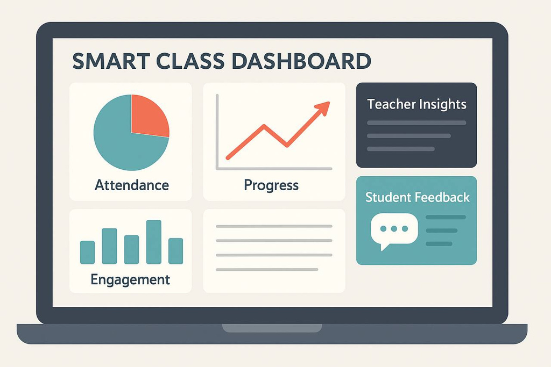

Big Data Analysis
PROPOSED SOLUTION/RECOMMENDATION
Develop a Smart Class Dashboard tailored to our university’s specific needs.
Features real-time tracking of attendance, participation, and academic progress.
Equips teachers with actionable insights and facilitates anonymous student feedback.

Slide 19

CONCLUSION
Big Data and EdTech present transformative opportunities to personalize and enhance education.
Implementation challenges such as cost and user adoption require strategic management.
Our solution offers a pragmatic approach balancing innovation with usability to support both students and educators.
SG

Slide 20
Educational Technology
REFERENCE
Johnson, R. A., & Lee, M. S. (2022). Integrating Big Data in Education: Challenges and Innovations. Journal of Educational Technology and Data Science, 14(3), 215–228.
Kim, H., & Torres, A. J. (2021). The Rise of AI in Classrooms: Ethical and Practical Implications. International Review of EdTech Studies, 9(2), 98–112.
Zhang, Y. (2020). Augmented Reality and Virtual Reality in Higher Education: A Data-Driven Perspective. EdTech Insights Quarterly, 7(1), 34–49.
Martinez, D. & O'Connor, P. (2023). Teacher Resistance to Digital Transformation: A Qualitative Study. Journal of Modern Learning Systems, 10(4), 143–156.
UNESCO. (2022). The Future of Learning: Big Data and AI in Education. Retrieved from https://www.unesco.org/reports/learning-futures
SG

Slide 21
Big Data Analysis
Educational Teachnology
THANK YOU!
FOR YOUR ATTENTION
SG
25.05.2025

